Slide 1
IBM CAPSTONE PROJECT – The Battle of Neighborhoods: Cluster Analysis of AN OFFICE in NEW YORK

Slide 2
Business Problem
Finding the best location for an office as an entrepreneur is difficult because one is usually strapped for cash and requires the business to make money fast while making sure that the customers will be retained.
How can we help a new entreprenuer find the best location for a new office?

Slide 3
QUESTION
Which is the best office space location in New York?

Slide 4
Solution
Clustering popular spots around the city. The most popular location or hotspots will be the ones recommended to open an office. Some of the things to take into consideration when selecting an office are:
Accessibility/ convenience
Demographics
Costs
Competition

Slide 5
Data and Methodology
Data: The subway station was chosen as the central area as people can take the subway to the office. A radius of 500 meters was chosen and all facilities that fall within the radius were collected. This is data on amenities and essential facilities surrounding such Post Office from FourSquare API interface.
Data: merging data on New York and hotspots of the city (areas with more population).
Methodology:
Collect Inspection Data;
Explore and Understand Data;
Data preparation and preprocessing;
Modeling

Slide 6
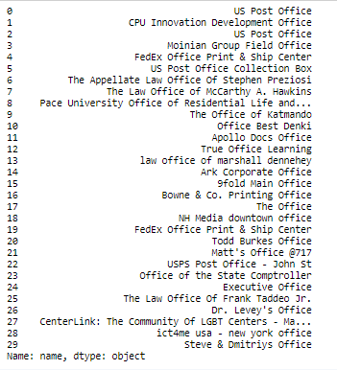
OFFICES WITHIN THE RADIUS

Slide 7
RESULTS
The properties that fall within the radius were selected and Foursquare was used to find the place with the most traffic. This is the place that a lot of people pass by which means that it is accessible and can be located. However as there is less traffic during the COVID-19 pandemic another method had to be selected. The entrepreneur can make the decision by looking at the competition and complementary businesses in the neighborhood.

Slide 8
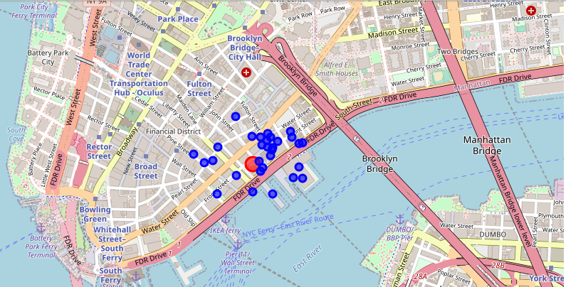
MAP OF THE RADIUS

Slide 9
Outcome:
Examination of real estates according to neighborhoods/London areas
West London (Notting Hill, Kensington, Chelsea, Marylebone) and North-West London (Hampsted) might be considered highly profitable venues to purchase a real estate;
South-West London (Wandsworth, Balham) and North-West London (Isliington) are arising as next future elite venues with a wide range of amenities and facilities.
Examination of real estates by clusters
Clusters 0, 2 and 4 may target home buyers prone to live in 'green' areas with parks, waterfronts;
Clusters 1 and 3 may target individuals who love pubs, theatres and soccer.

